Slide 1
Characterizing the CD34+ cells in bone marrow single-cell RNA-seq dataset
Zinger Yang Loureiro
May 9, 2022

Slide 2
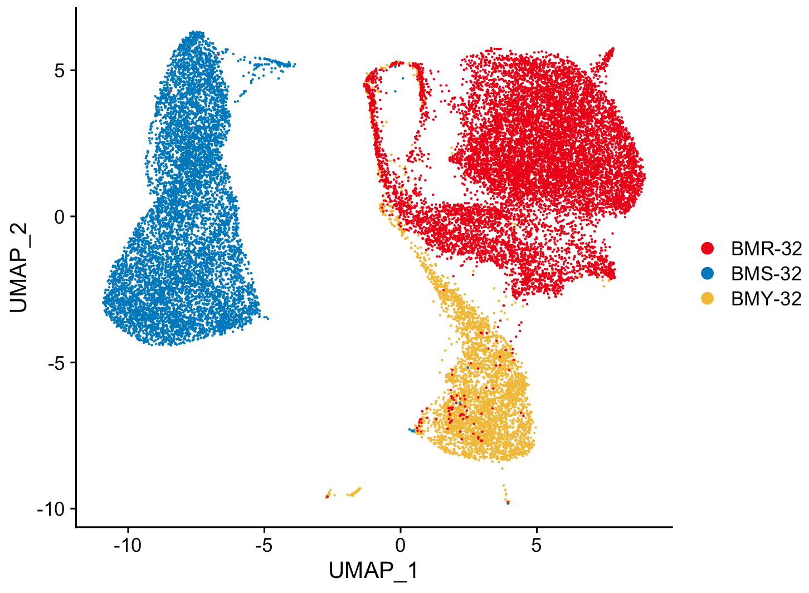
Dispased cells
Iteration 3, min.feature = 2000
# cells passed qc
BMR-32 12307
BMS-32 8688
BMY-32 3947

Slide 3
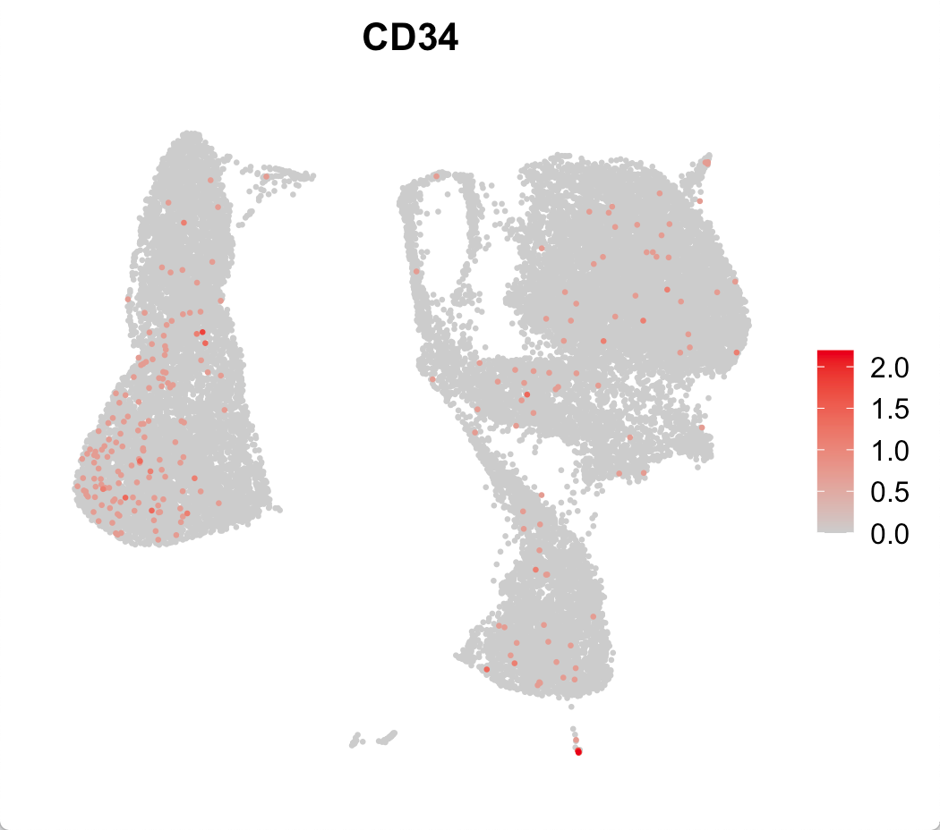
CD34+ cells do not form distinct cell cluster by gene expression Iteration 3, min.feature = 2000
# cells with non-zero CD34 raw count
BMR-32 59 of 12307 (0.48%)
BMS-32 148 of 8688 (1.70%)
BMY-32 37 of 3947 (0.94%)
# cells with non-zero CD34,THY1 raw count
BMR-32 41
BMS-32 123
BMY-32 26

Slide 4
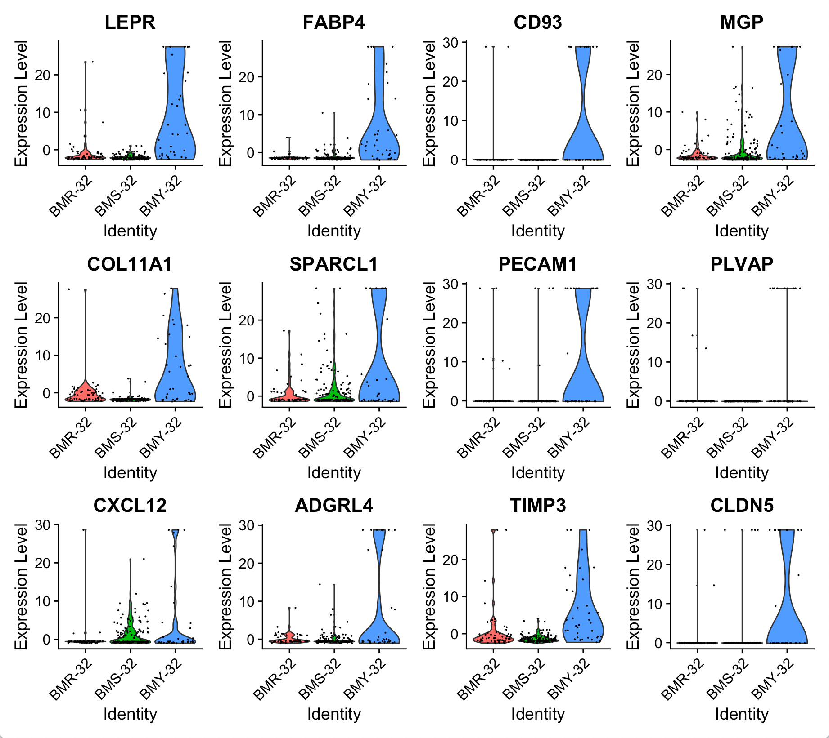
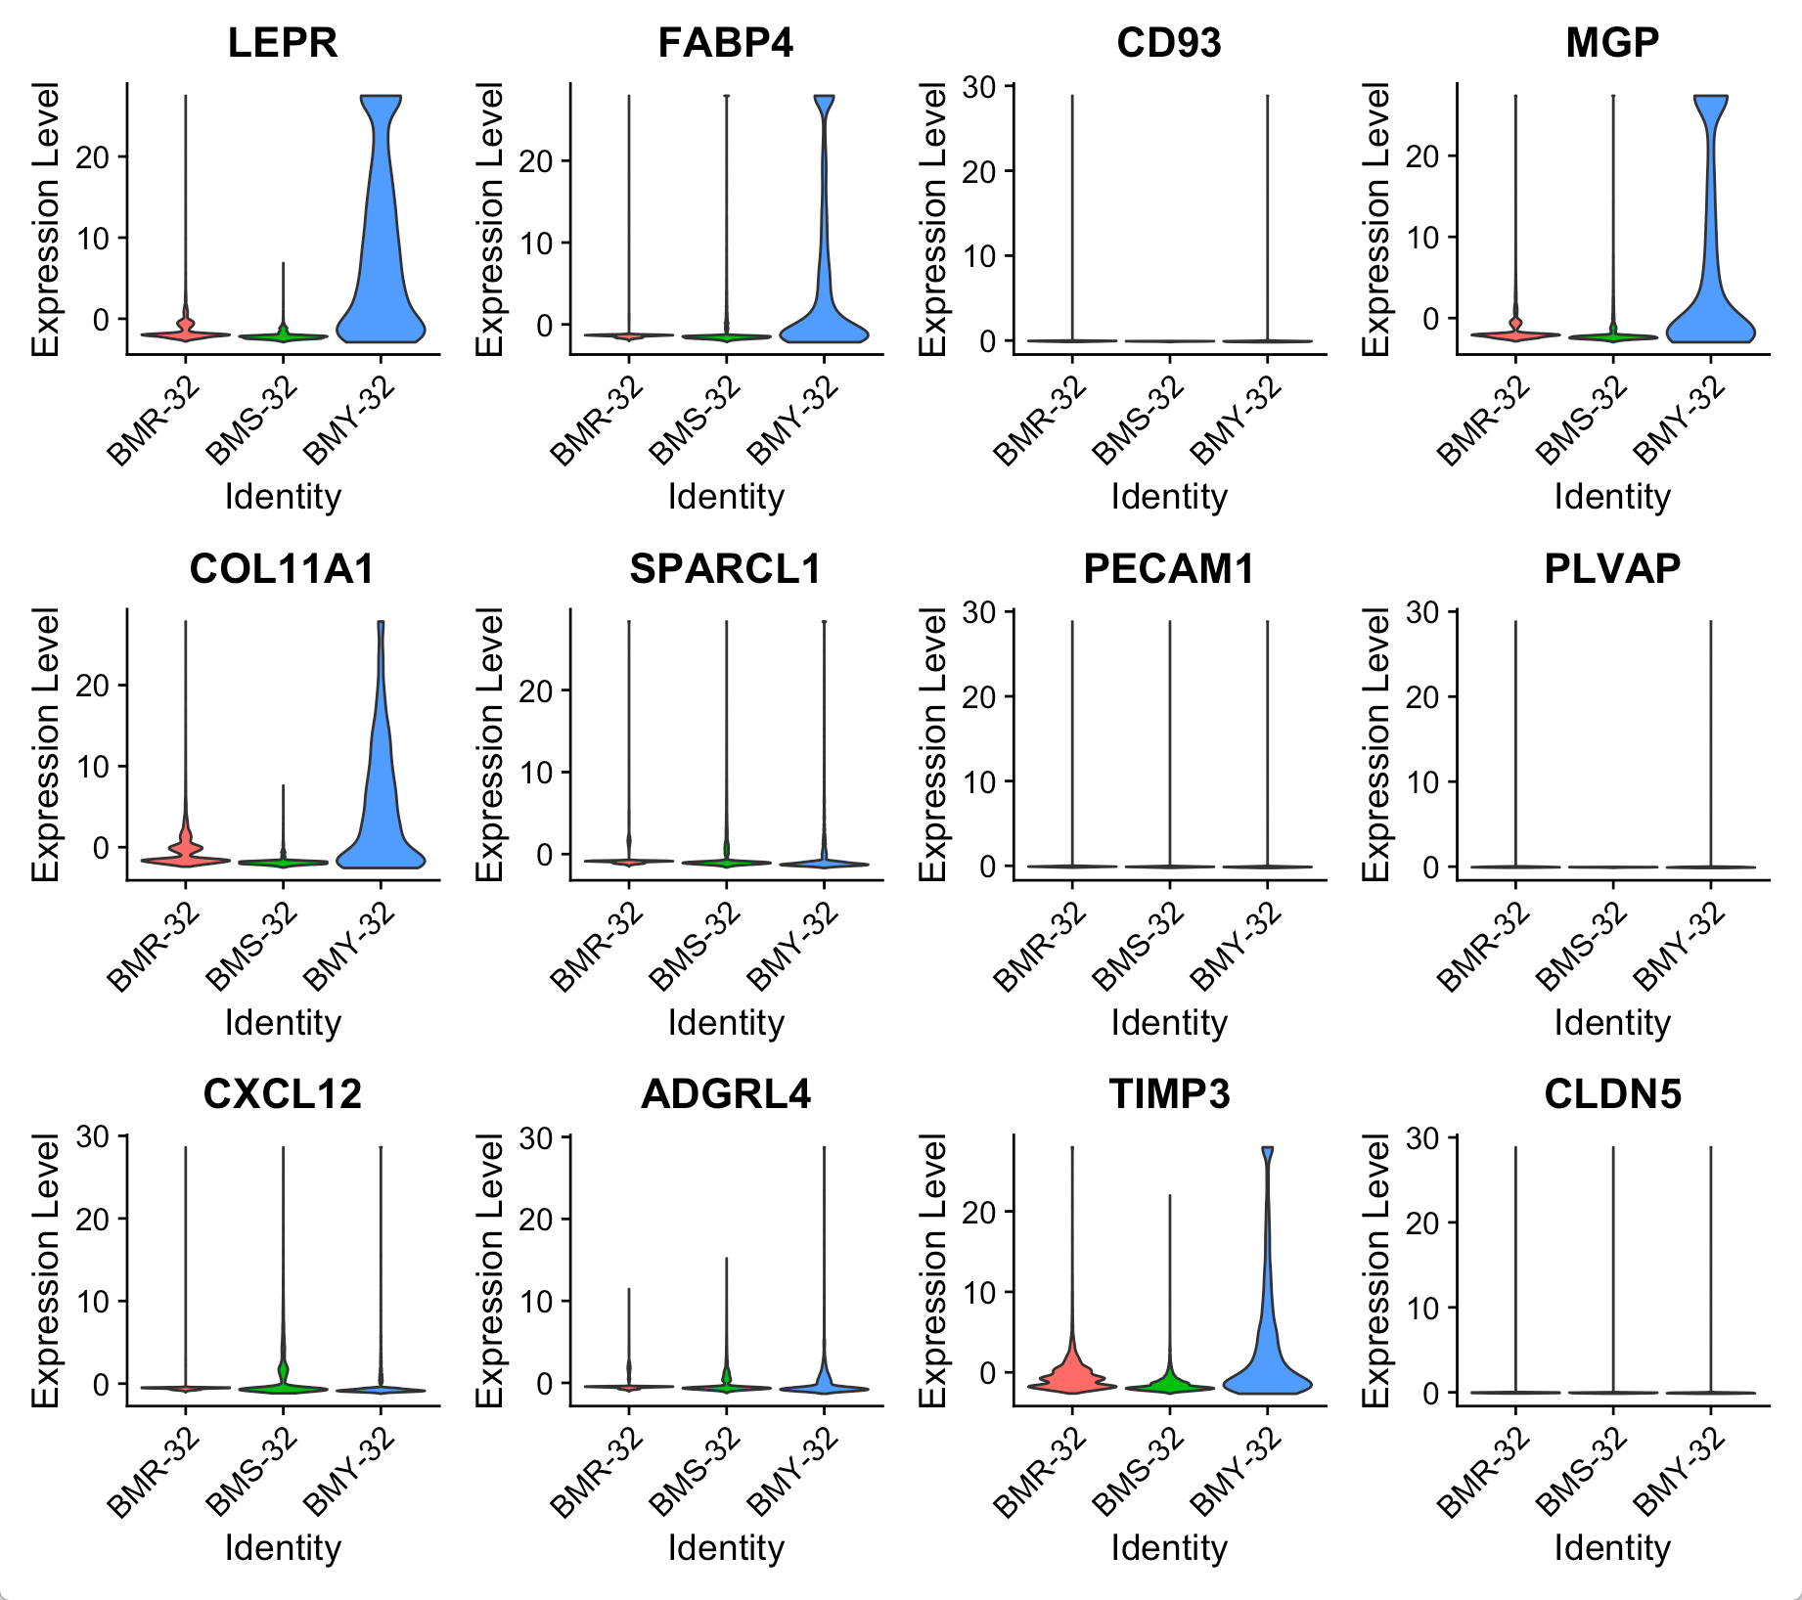
BMY CD34+ cells differential gene expression by sample BMY vs (BMR + BMS)
Among CD34+ cells
All cells
Notes:
test.use = "wilcox", min.pct = 0.1,

Slide 5
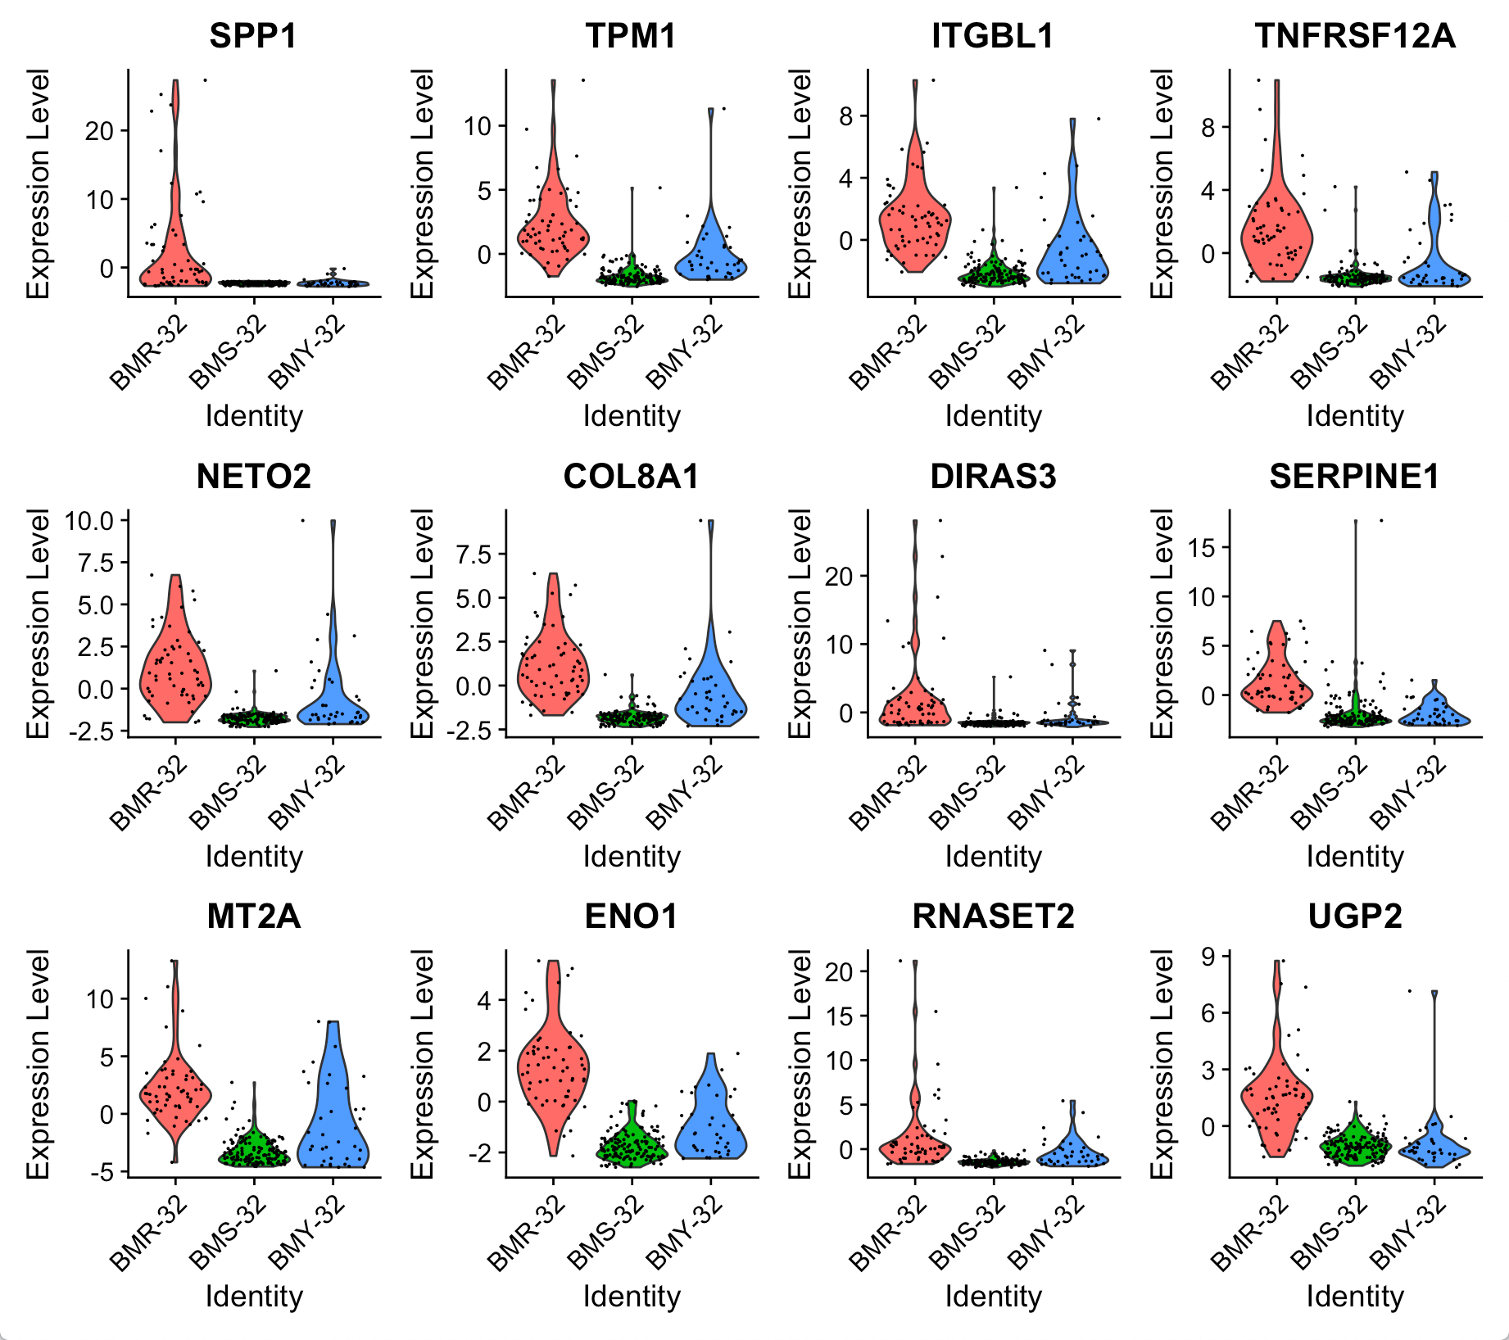
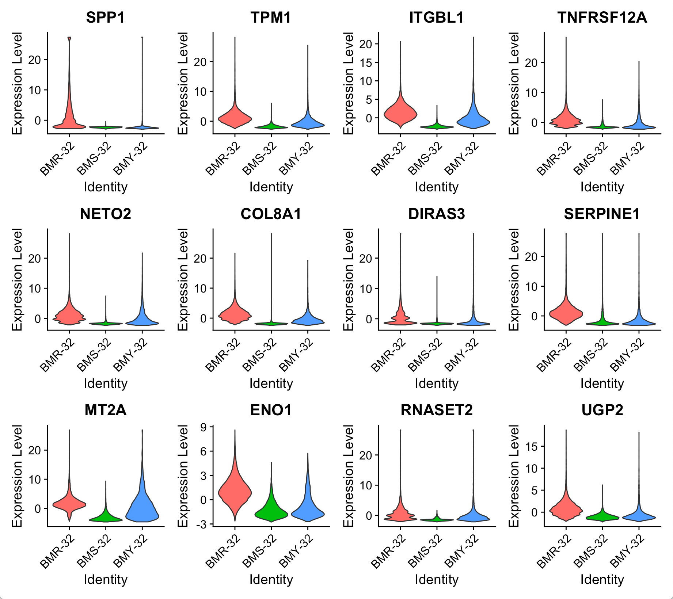
BMR CD34+ cells differential gene expression by sample BMR vs (BMY + BMS)
Among CD34+ cells
All cells

Slide 6
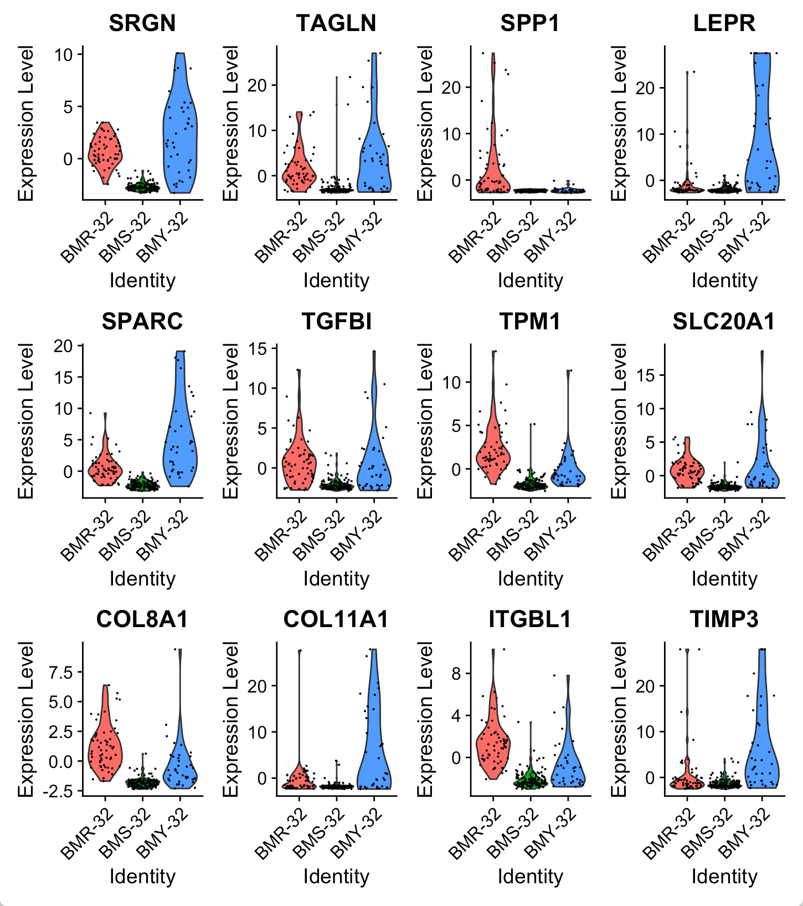
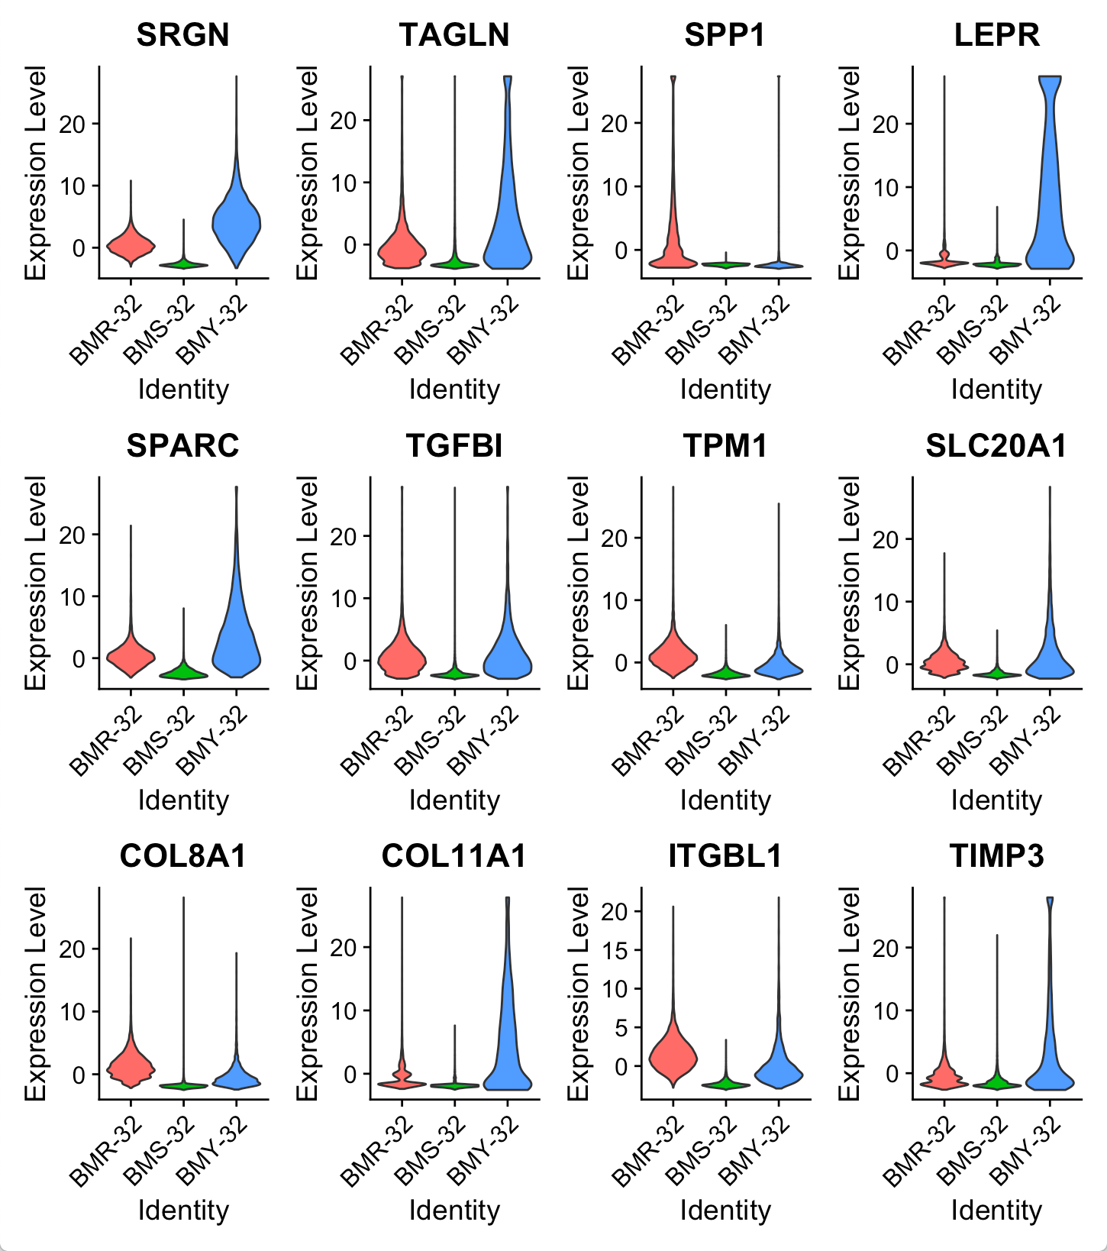
BMY/BMR vs BMS
Among CD34+ cells
All cells

Slide 7
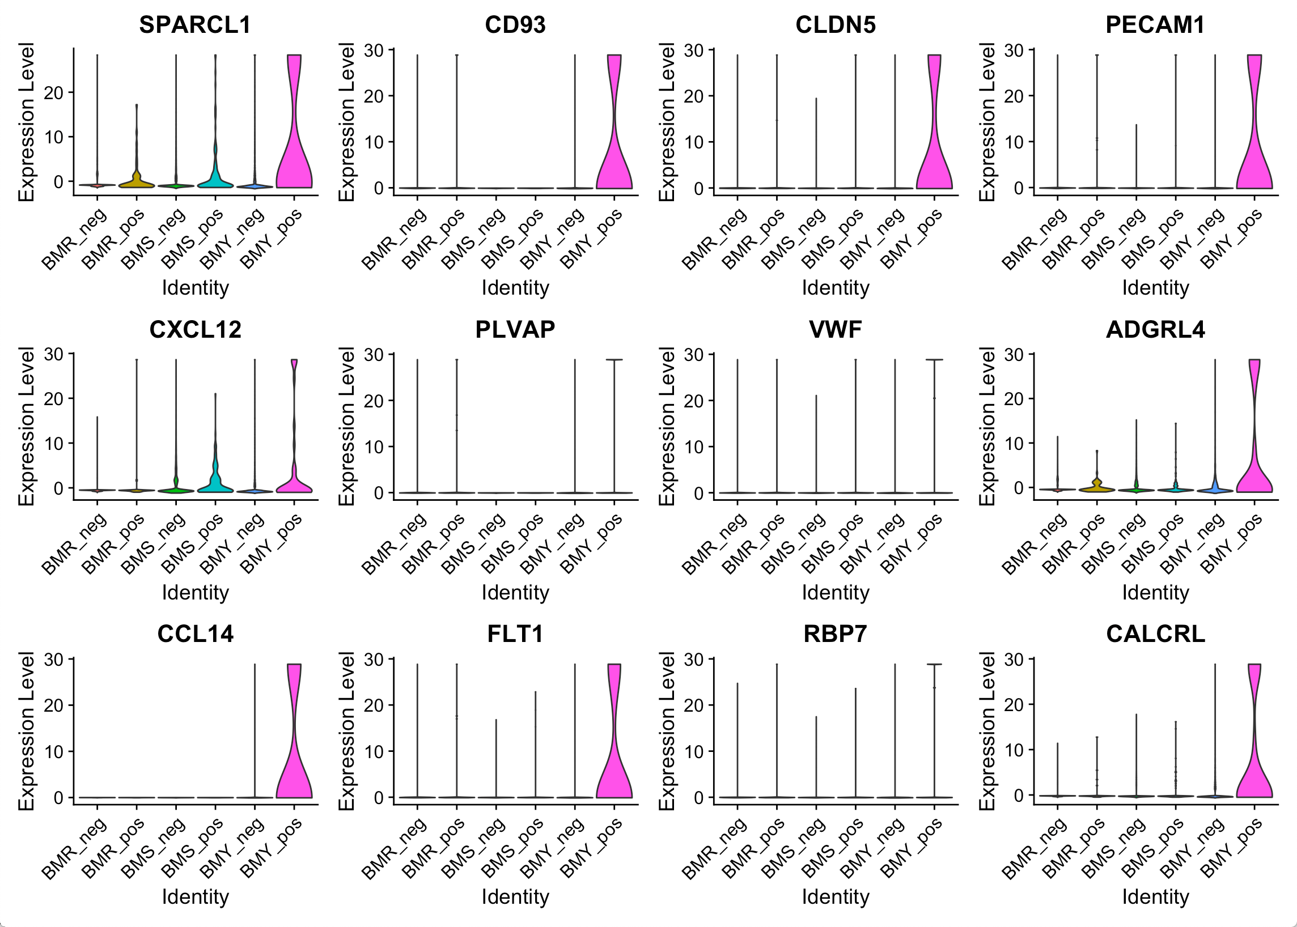
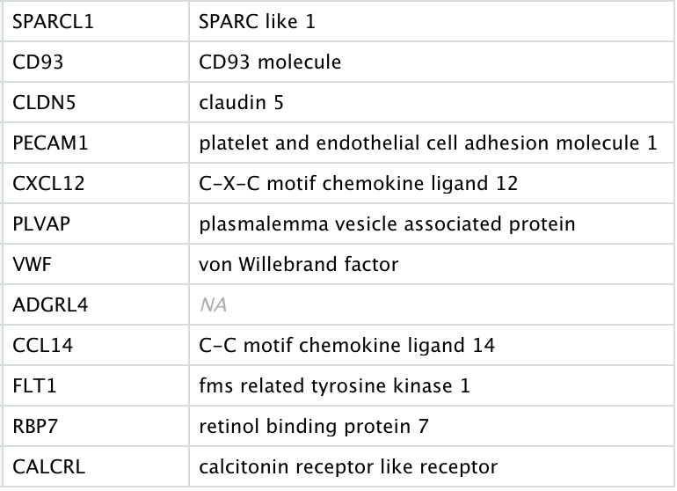
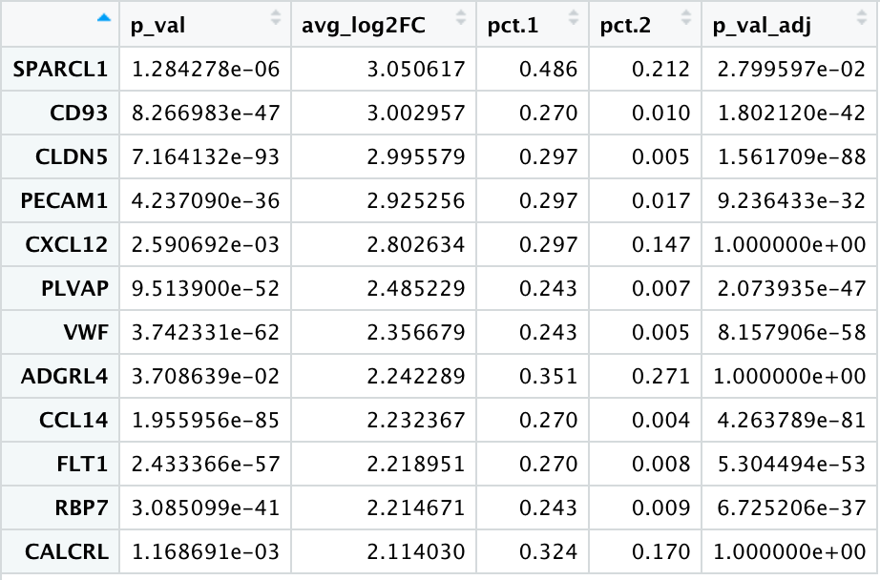
Differential expression analysis between CD34+ and CD34- BMY cells
Differential Expression Analysis: Wilcoxon Rank Sum Test, log2fc > 0.5, expressed in > 10% of cells in one of the groups
383 genes with log2fc > 0.5
Adhesion G Protein-Coupled Receptor L4

Slide 8
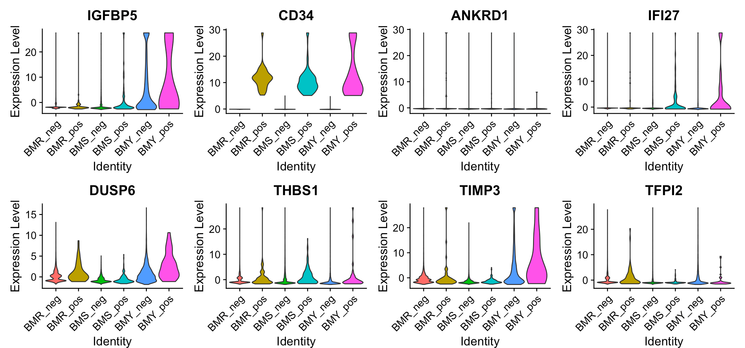
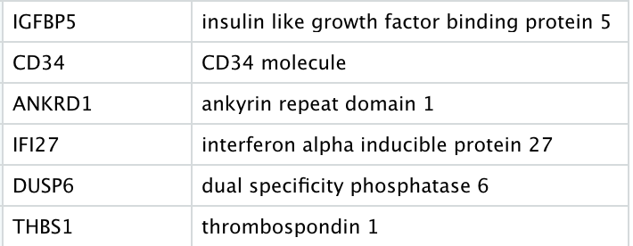
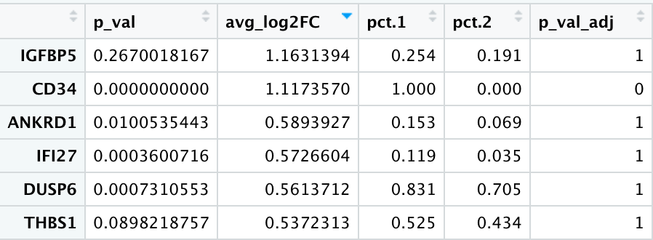
Differential expression analysis between CD34+ and CD34- BMR cells
Differential Expression Analysis: Wilcoxon Rank Sum Test, log2fc > 0.5, expressed in > 10% of cells in one of the groups
6 genes with log2fc > 0.5

Slide 9
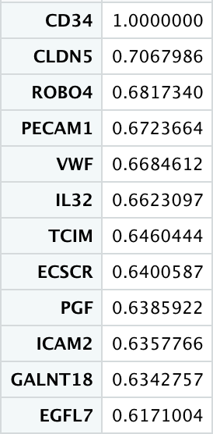
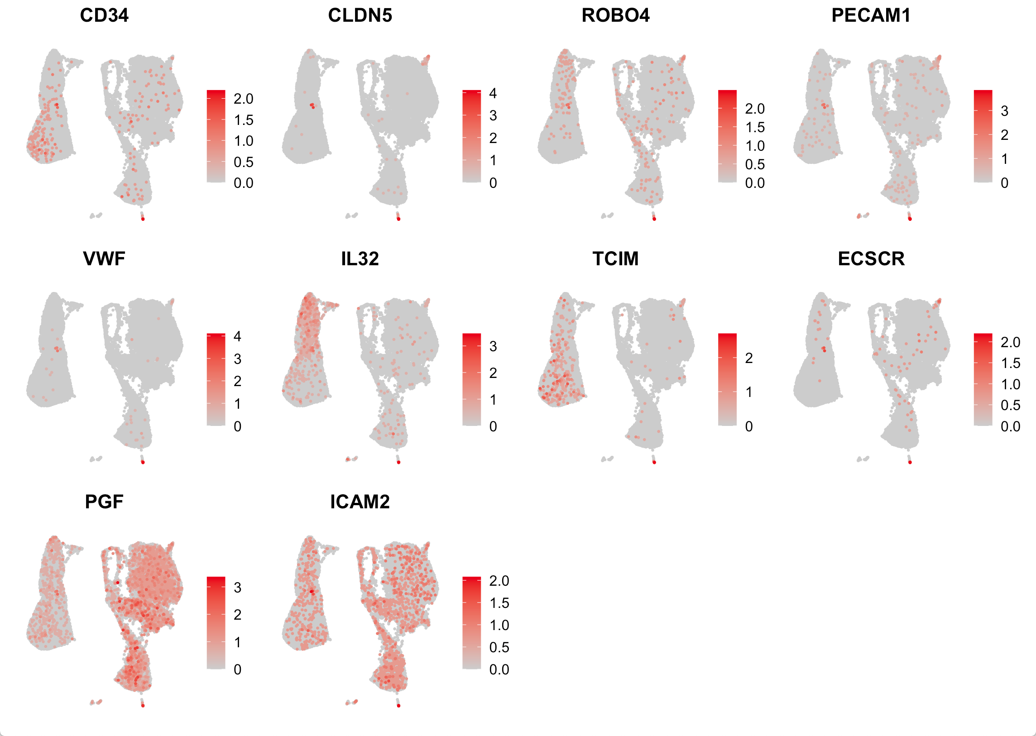
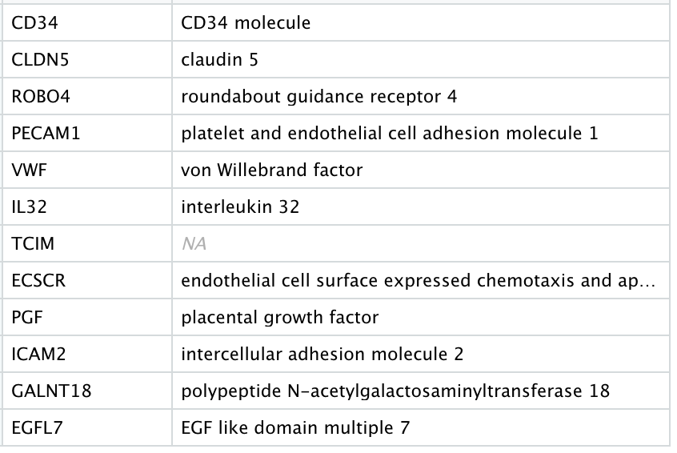
Top correlating genes to CD34 among the 244 CD34+ cells, regardless of origin
Transcriptional And Immune Response Regulator

Slide 10
(CD34+_BMY / CD34+ _BMS) – (CD34-_BMY/CD34-_BMS)

Slide 11
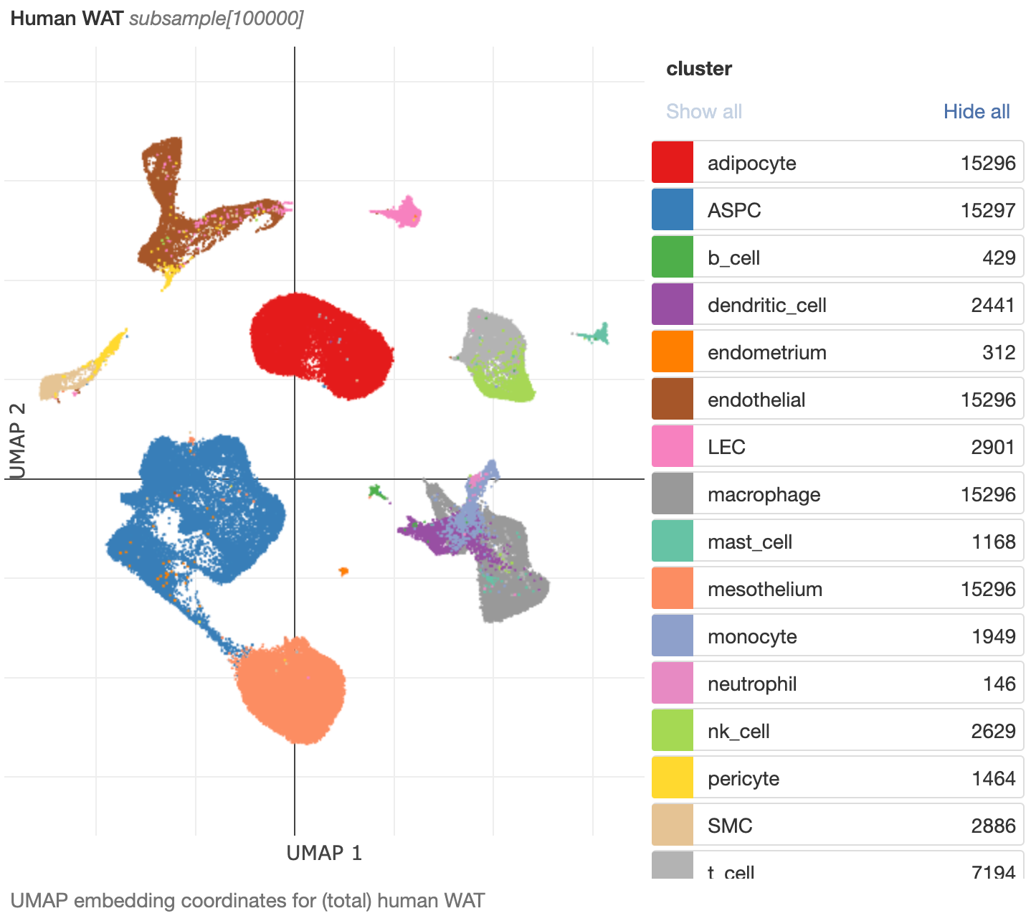
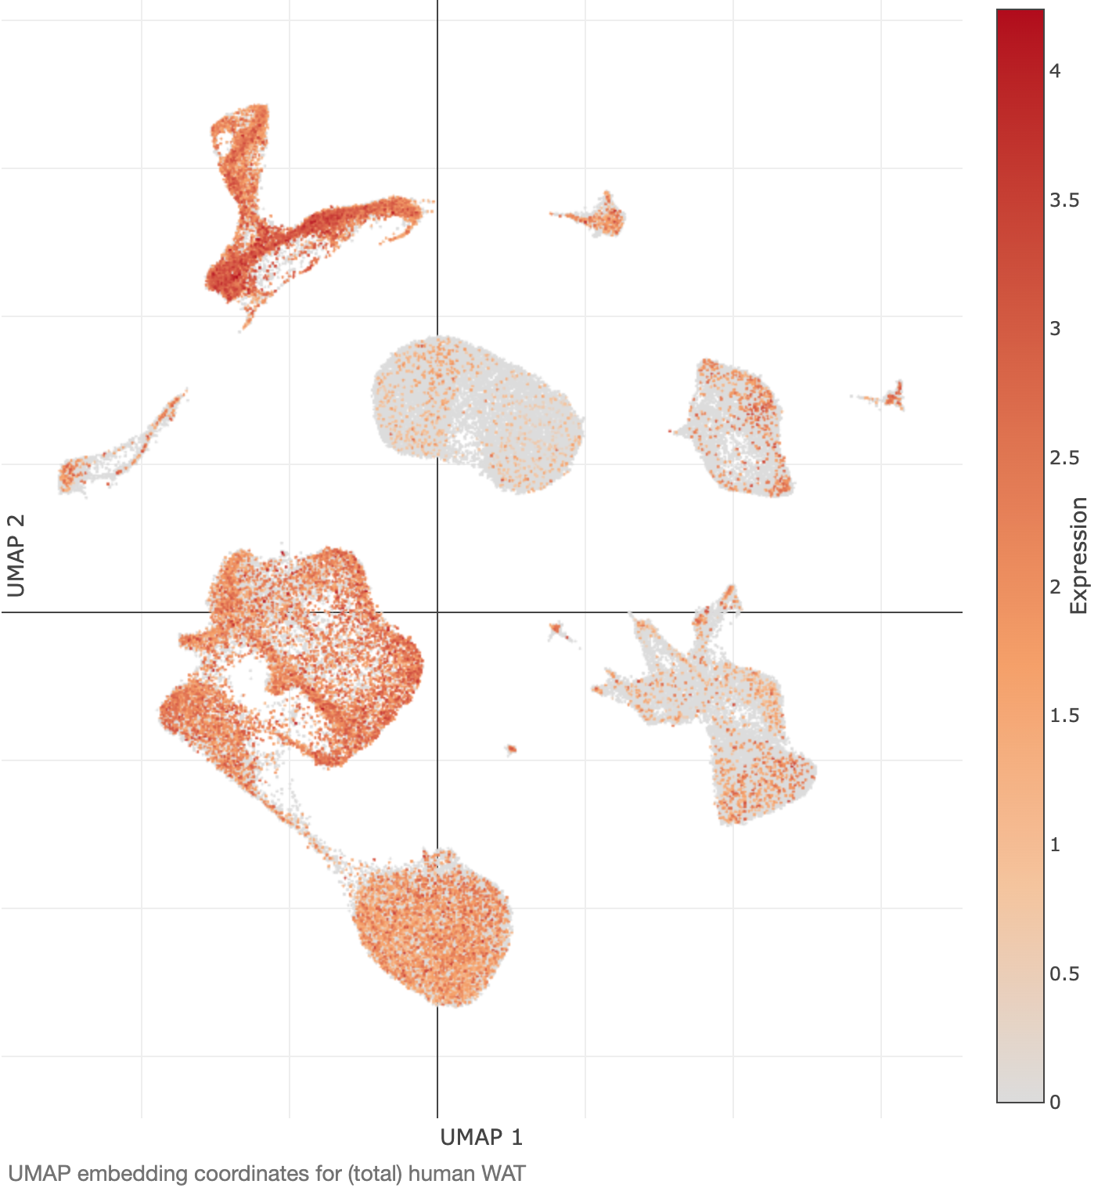
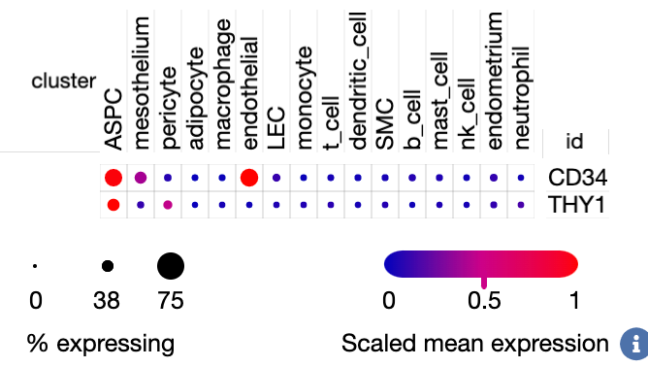
42.33% ASPCs express CD34

